Slide 1
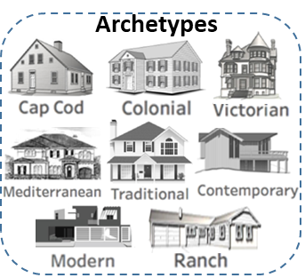
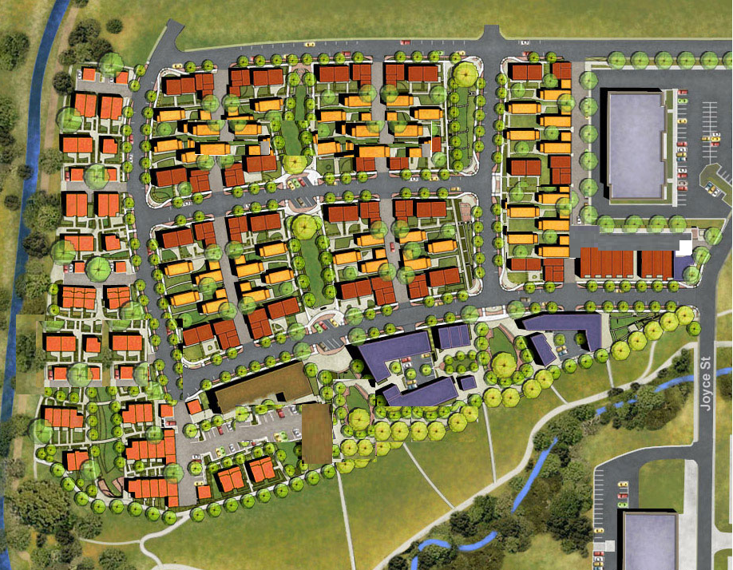

Slide 2
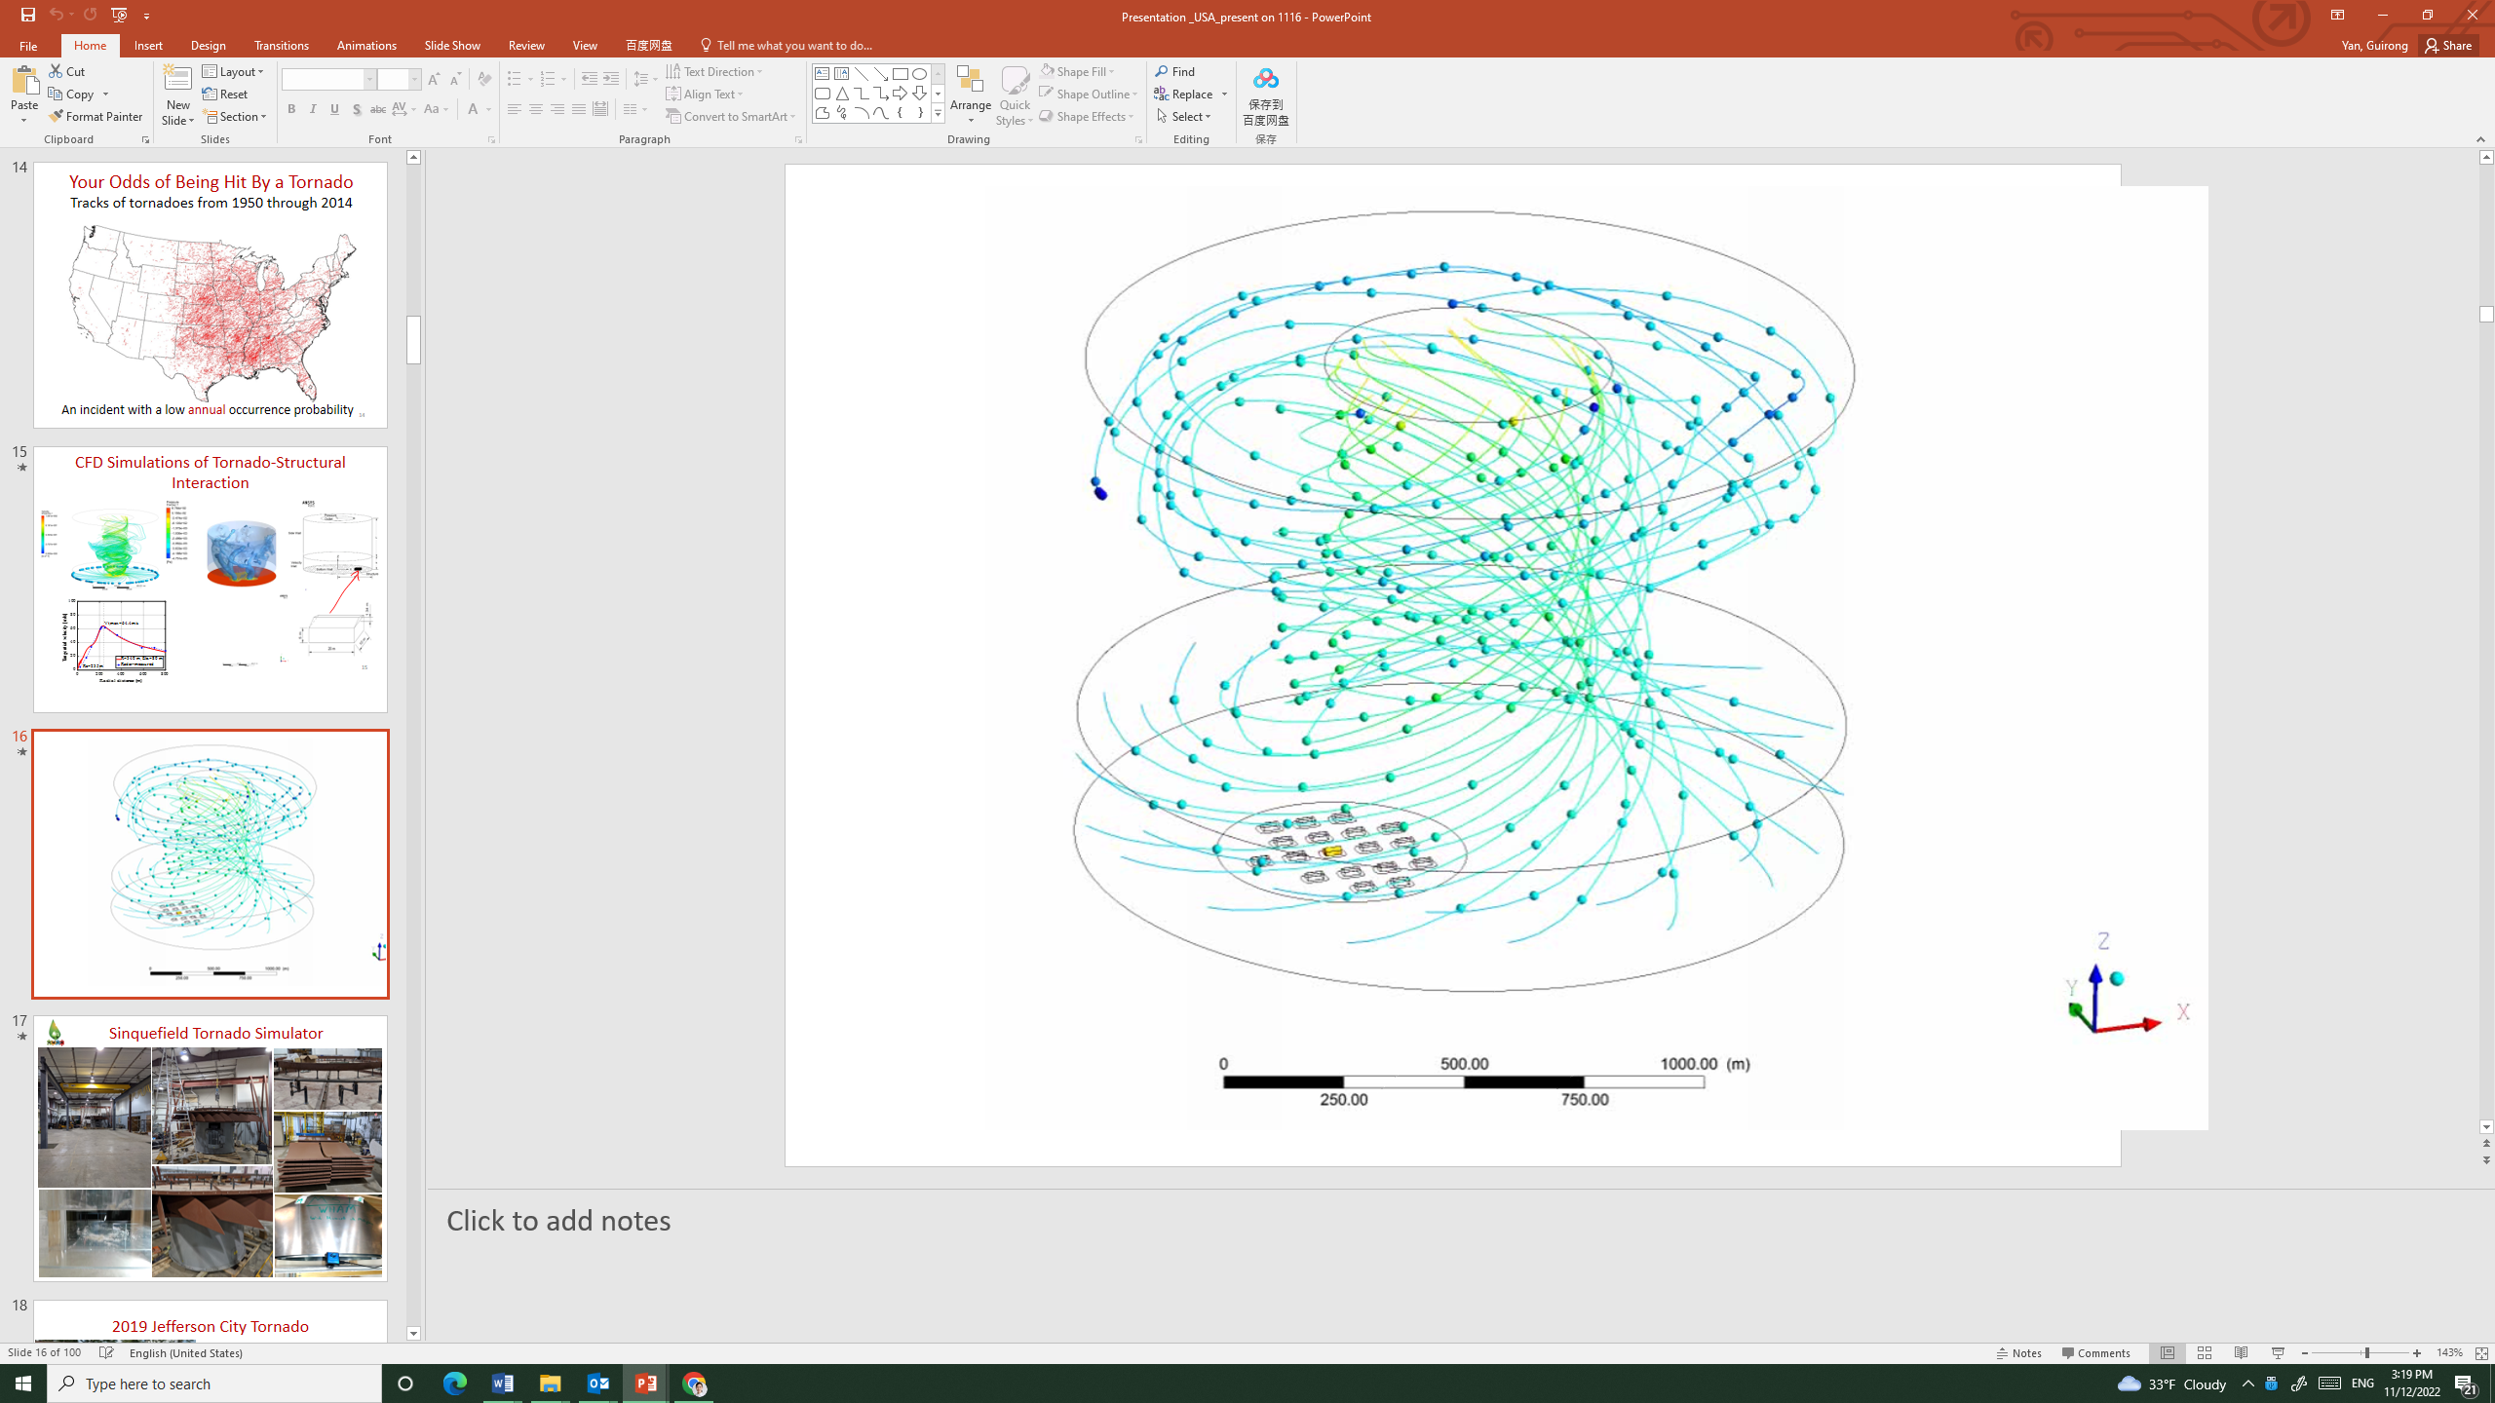
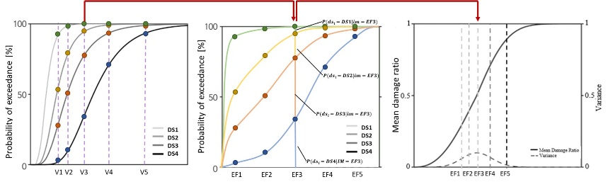

Slide 3
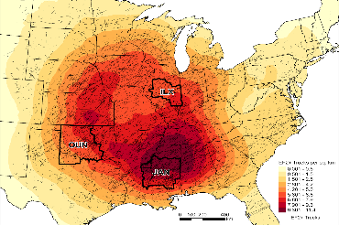

Slide 4


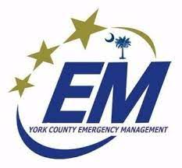


Slide 5

Task 1: Extract building attributes using DL
Task 2: Develop structural fragility &vulnerability to tornadoes
BAs
Building Attributes
(BAs)
Damage visualization
Structural vulnerability
OUN
ILX
JAN
Task 3: Propose the combined structural fragility and vulnerability index to tornadoes
Task 4: Study risk perception
& capacity for Mitigation
Fig. 4. EF2+ tornado tracks (1950-2021), with 3 selected CWAs highlighted.

